Slide 1
06 ARMv7-M (Cortex-M4) & nRF52840 & Interrupts
ECE30070 Microprocessor Application
HGU-Technonia

Slide 2
Documents
ARM Cortex-M4 Processor Technical Reference Manual
Web version: https://developer.arm.com/documentation/100166/latest/
Pdf version: https://documentation-service.arm.com/static/5fce431be167456a35b36ade?token=
ARM ARMv7-M Architecture Reference Manual (including DSP extension a.k.a. ARMv7E-M; and Thumb-2 Instructions)
Pdf version: https://developer.arm.com/documentation/ddi0403/latest/
Nordic nRF52840 microcontroller
Website: https://www.nordicsemi.com/Products/nRF52840
Product specification: https://infocenter.nordicsemi.com/index.jsp?topic=%2Fstruct_nrf52%2Fstruct%2Fnrf52840.html
Nordic nRF52840 DK board
Website: https://www.nordicsemi.com/Products/Development-hardware/nRF52840-DK
Documents: https://infocenter.nordicsemi.com/index.jsp?topic=%2Fug_nrf52840_dk%2FUG%2Fdk%2Fintro.html
Notes:
ARMv7E-M is an enhanced version of ARMv7-M.
This architecture is suited for more complex applications requiring DSP (Digital Signal Processing) tasks or floating-point calculations.
Advanced interrupt management and real-time processing capabilities have been improved.

Slide 3
Agenda
Interrupts and Exceptions
NVIC
GPIOTE
Interrupt Advanced Topic

Slide 4

Interrupts and Exceptions
Interrupts and exceptions are mechanisms that alter the normal flow of execution in a microcontroller to handle events (like external signals or internal system events).
Interrupts
These are signals sent by external devices, such as sensors or timers, to the processor, indicating that an event has occurred which requires immediate attention.
Interrupts can be masked or unmasked, which means they can be temporarily ignored if necessary.
external devices
processor
interrupt
main task

Slide 5

Interrupts and Exceptions
Exceptions
These are types of interrupts that are triggered internally by the CPU itself due to exceptional conditions during program execution, such as division by zero, accessing invalid memory, etc.
Commonly, interrupt is considered as one of exception types.
“Go to page 120 of this lecture material”
↓
But it has no p.120.
↓
Exception!

Slide 6
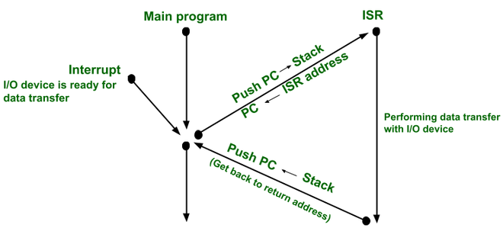
Interrupts and Exceptions
Exception Handling Process
An exception halts the processor's operations to handle events such as external interrupts or attempts to execute undefined instructions.
It updates various information related to the cause of the exception in the registers.
The processor branches to a pre-determined address (to an ISR, Interrupt Service Routine) specific to the type of exception by looking up the vector table.

Slide 7
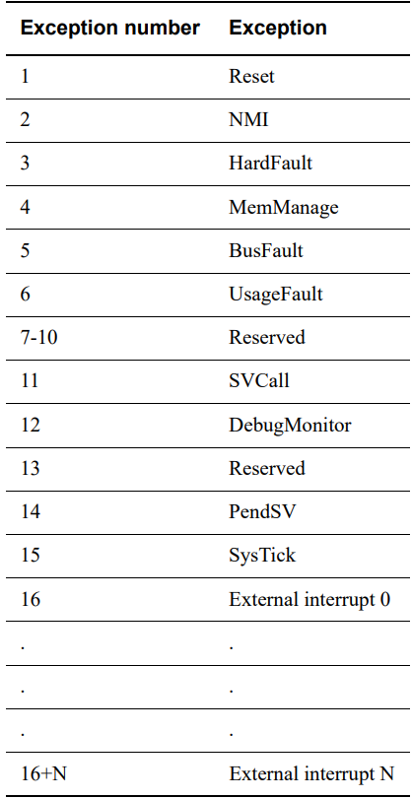
Interrupts and Exceptions
Exceptions and Numbers
Reset: Reset (priority of -3)
NMI: Non-Maskable Interrupt (priority of -2)
HardFault: for unrecoverable system failures (priority of -1)
MemManage: handles memory protection
BusFault: handles memory-related faults
UsageFault: handles non-memory related faults caused by instruction execution
DebugMonitor: a synchronous exception (debug watchpoint)
SVCall: Supervisor Call handles the exception caused by the SVC instruction.
Interrupts
PendSV: used for software-generated system calls
SysTick: generated by the SysTick timer
External interrupt N: N is up to 496.

Slide 8
Interrupts and Exceptions
Vector Table
The vector table contains the initialization value for the stack pointer, and the entry point addresses of each exception handler.
The vector table initially starts at address 0x00000000.
It can be relocated by setting VTOR in the privileged mode.
The exception number defines the order of entries in the vector table.
Address | Exception number | value
0x00000000 | - | Main Stack Pointer’s initial value
0x00000004 | 1 | Reset vector (PC initial value)
0x00000008 | 2 | NMI handler starting address
0x0000000C | 3 | Hard fault handler starting address
0x00000010 | 4 | MemManage fault handler address
0x00000014 | 5 | Bus fault handler address
0x00000018 | 6 | Usage fault handler address
0x0000002C | 11 | SVCall handler address
0x00000038 | 14 | PendSV handler address
0x0000003C | 15 | SysTick handler address
0x00000040 | 16 | IRQ0 handler address
… | … | Other IRQn handler addresses

Slide 9
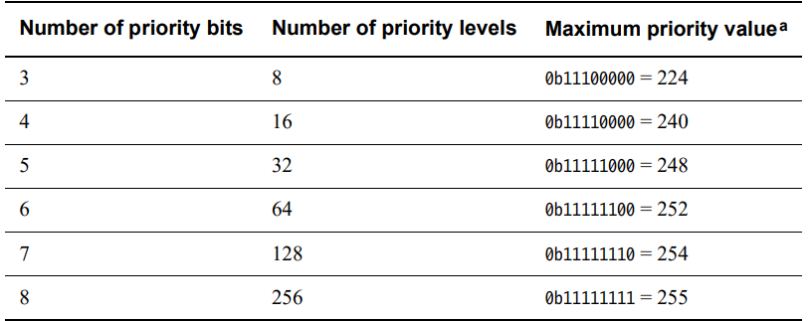

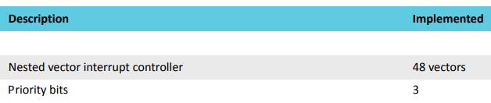
Interrupts and Exceptions
Exception Priority
All exceptions have an associated priority from 0 up to 256.
nRF52840 has priority bits of 3, thus, it supports 8 priority levels.
A lower priority value indicating a higher priority.
from nRF52840 document
https://www.washingtonpost.com/news/inspired-life/wp/2015/06/01/interruptions-at-work-can-cost-you-up-to-6-hours-a-day-heres-how-to-avoid-them/

Slide 10
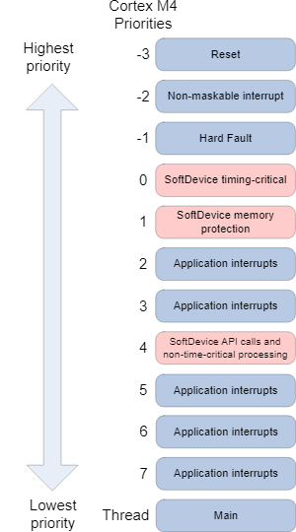
Interrupts and Exceptions
Exception Priority
Configurable(programmable) priorities for all exceptions except Reset, NMI, and HardFault
All exceptions with a configurable priority have a priority of 0 in default.
No. | Exception Type | Priority | Descriptions
1 | Reset | -3 (Highest) | Reset
2 | NMI | -2 | Non-Maskable Interrupt
3 | Hard Fault | -1 | Default fault if others hander not implemented
4 | MemManage Fault | programmable | MPU violation or access to illegal locations
5 | Bus Fault | programmable | Fault if AHB interface receives error
6 | Usage Fault | programmable | Invalid instructions
7-10 | Reserved | N.A.
11 | SVC | programmable | System Service call (for RTOS entry calls)
12 | Debug Monitor | programmable | Break points, watch points, external debug
13 | Reserved | N.A.
14 | PendSV | programmable | Pendable System Call (for RTOS context switching)
15 | SYSTICK | programmable | System Tick Timer
16 | Interrupt #0 | programmable | External Interrupt #0
…… | ………………….. | programmable | …………………..
255 | Interrupt#239 | programmable | External Interrupt #239
example

Slide 11
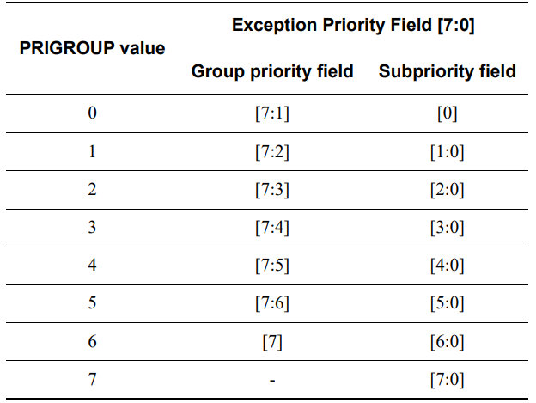
Interrupts and Exceptions
Priority Grouping
Group priority & Sub-priority within the group
If multiple pending exceptions have the same group priority, the exception processing logic uses the subpriority field AIRCR.PRIGROUP to resolve priority within the group.

Slide 12
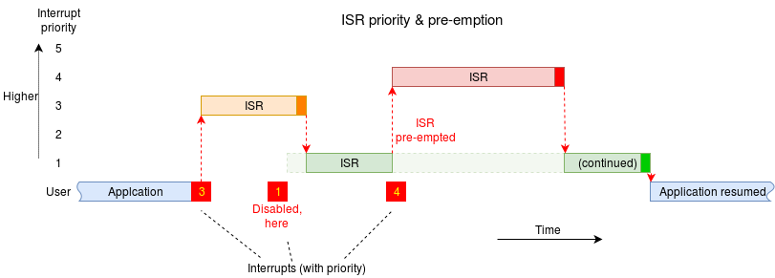
Interrupts and Exceptions
Exception Entry and Return
Preemption
Only the exception with the higher group priority than the exception being handled can preempt the current exception handler.
Return
Occurs when the exception handler is completed and there is no pending exception.
*ISR: Interrupt Service Routine
https://wiki.cs.manchester.ac.uk/COMP15212/index.php/Interrupt_Service_Routine

Slide 13
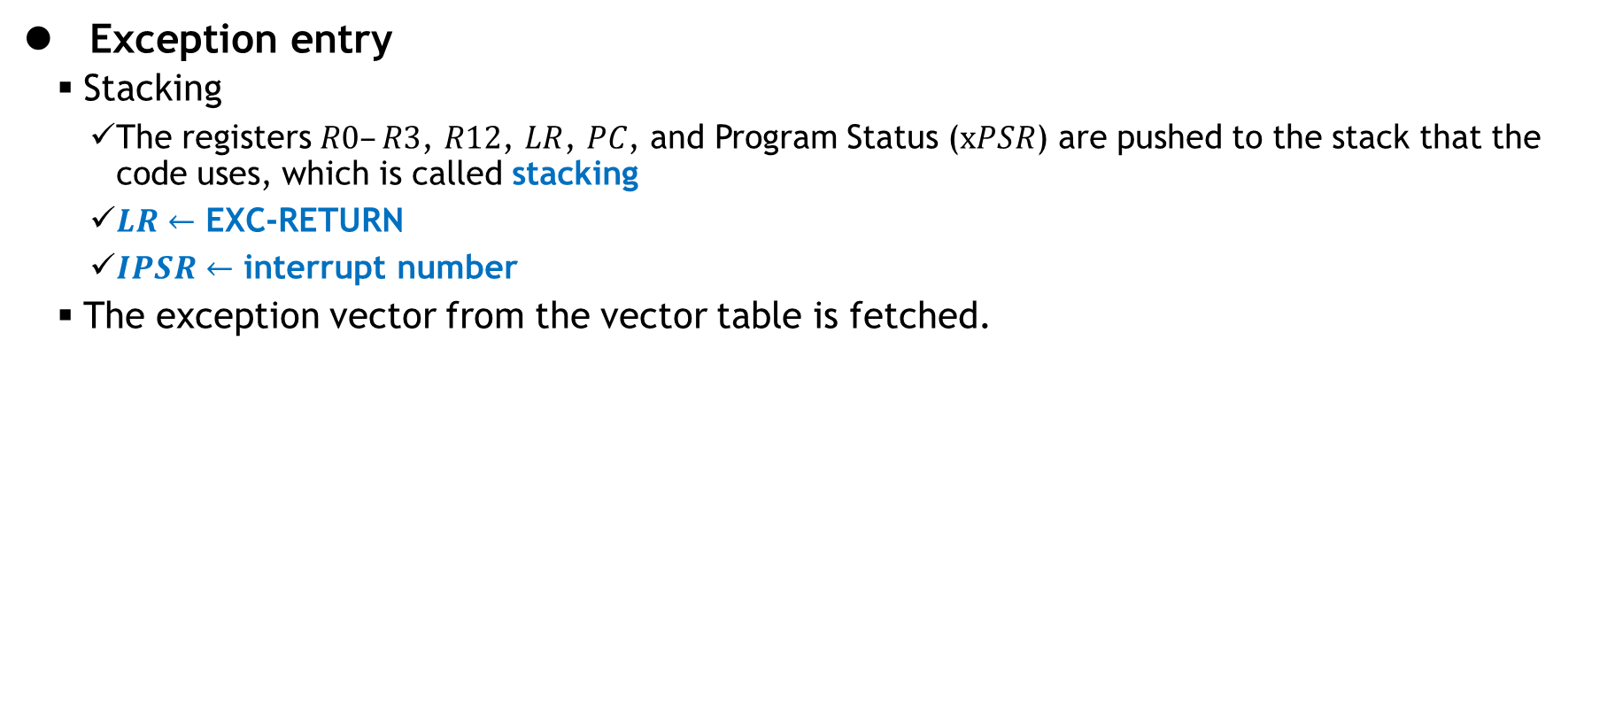
Interrupts and Exceptions
Exception entry
Stacking
The registers $R0–R3$, $R12$, $LR$, $PC$, and Program Status ($xPSR$) are pushed to the stack that the code uses, which is called stacking
$LR$ $←$ EXC-RETURN
$IPSR$ $←$ interrupt number
The exception vector from the vector table is fetched.

Slide 14
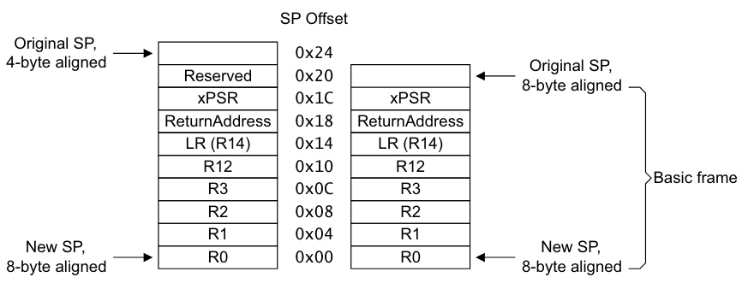
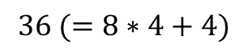
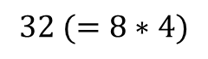
Interrupts and Exceptions
Exception entry
Stacking
8-byte alignment
In ARMv7-M architecture, it refers to aligning data in memory on 8-byte boundaries, which is crucial for optimizing memory access and enhancing performance.
$$36 (=8∗4+4)$$
$$32 (=8∗4)$$
new $sp$ is aligned to indicate an address that is $8∗n$.

Slide 15
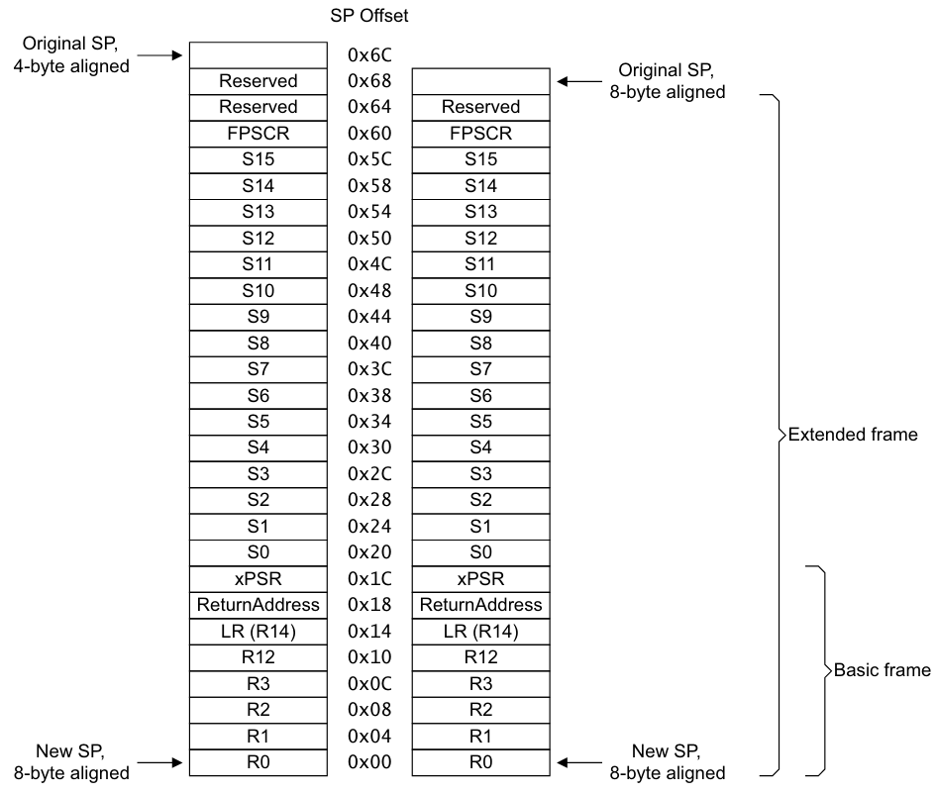
Interrupts and Exceptions
Exception entry
Stacking
Extended Stacking Frame

Slide 16
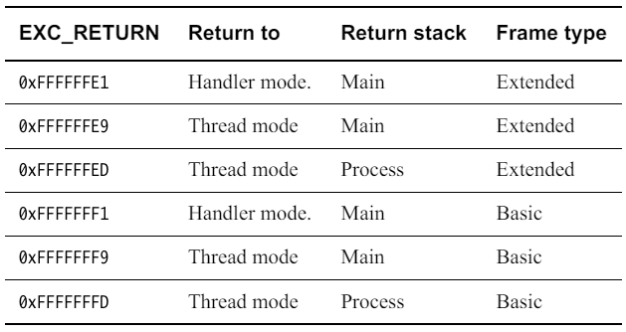
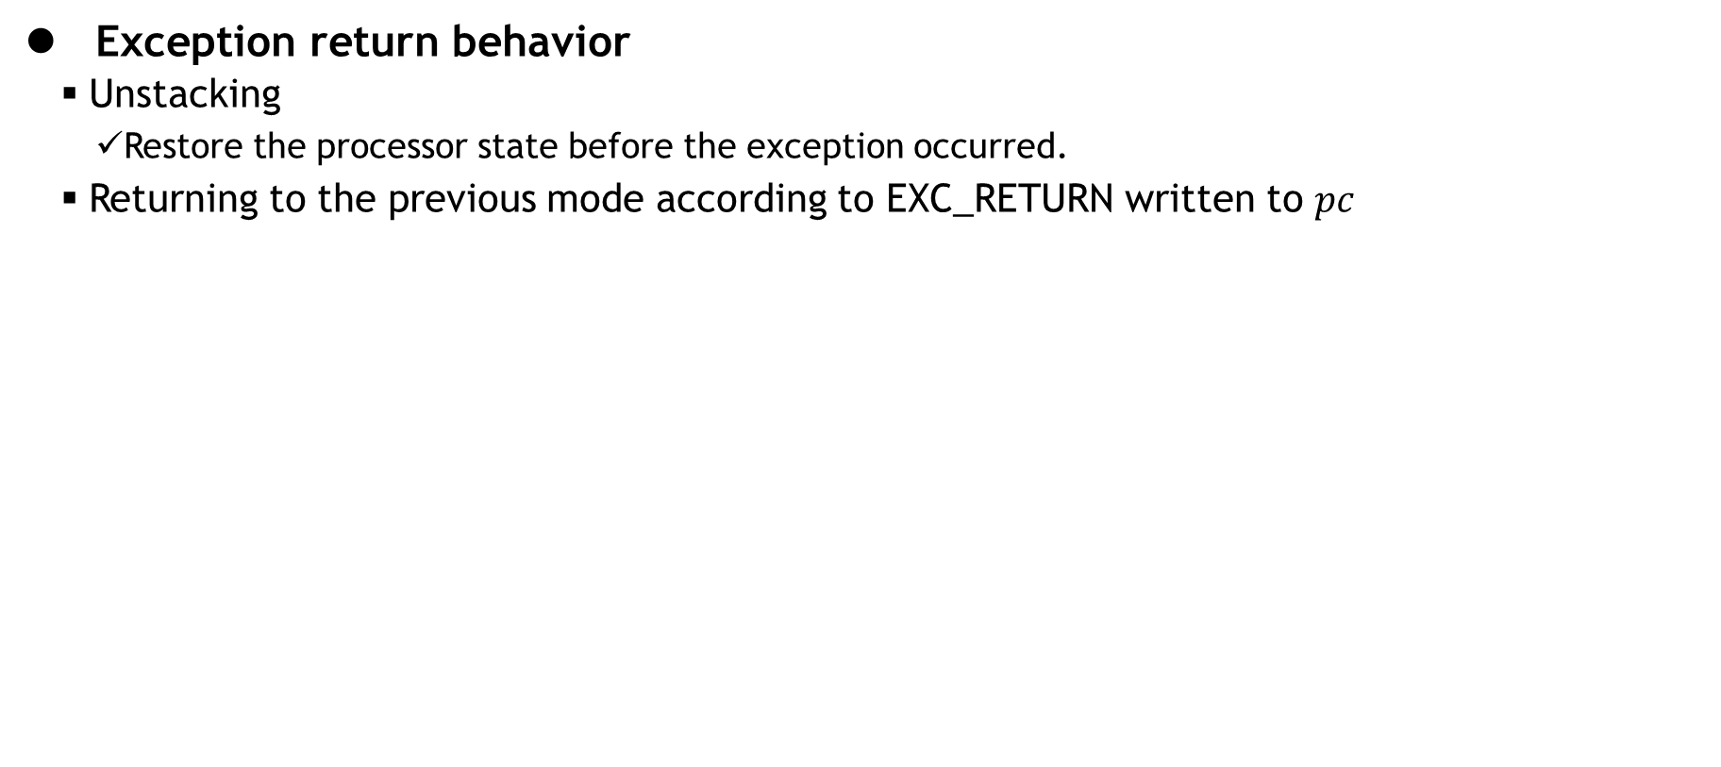
Interrupts and Exceptions
Exception return behavior
Unstacking
Restore the processor state before the exception occurred.
Returning to the previous mode according to EXC_RETURN written to $pc$

Slide 17
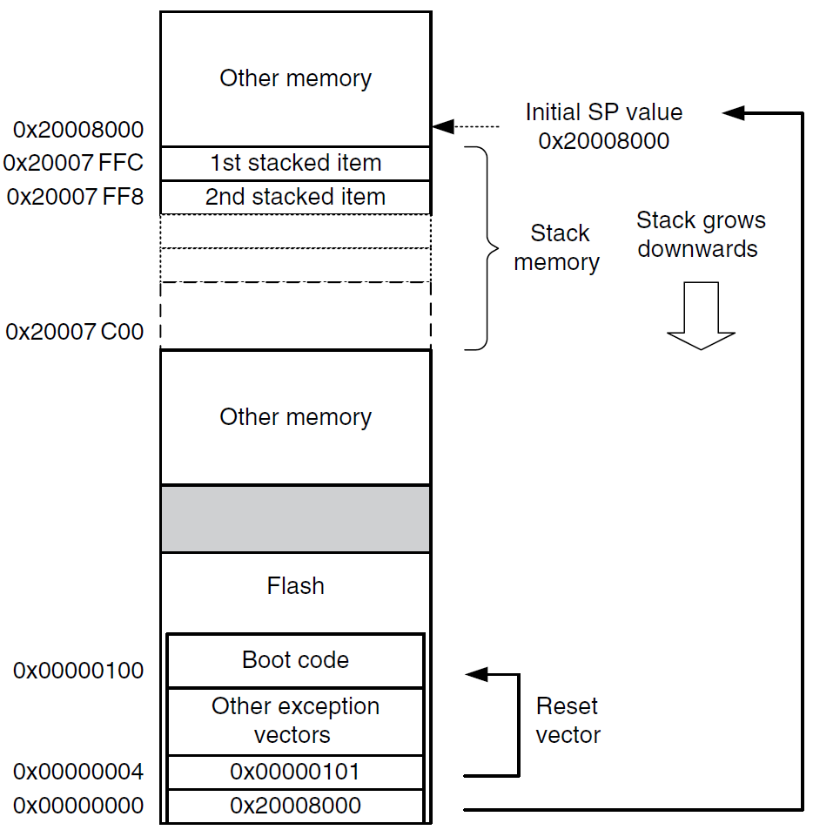
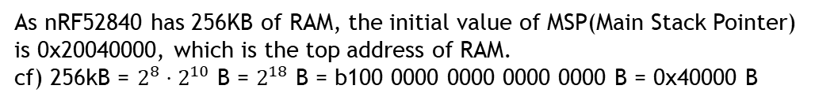
Interrupts and Exceptions
Reset Sequence
Read the value at the address 0x0, set R13(SP) with the value.
Read the reset vector at the address 0x04, and fetch instructions from the address and execute them.
The contents of the vector table are address values not branch instructions.
vector addresses in the vector table should have their LSB set to 1 to indicate that they are Thumb code.
0x20040000
0x20040000
0x2003fffc
0x2003fff8
As nRF52840 has 256KB of RAM, the initial value of MSP(Main Stack Pointer) is 0x20040000, which is the top address of RAM.
cf) 256kB = $2^{8}⋅2^{10}$ B = $2^{18}$ B = b100 0000 0000 0000 0000 B = 0x40000 B
0x0000008e
0x0000008F
0x20040000
The address value is equal to the actual address + 1 to let the processor know that the instructions to be executed are Thumb instructions.

Slide 18
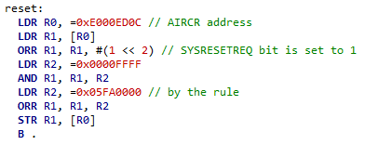
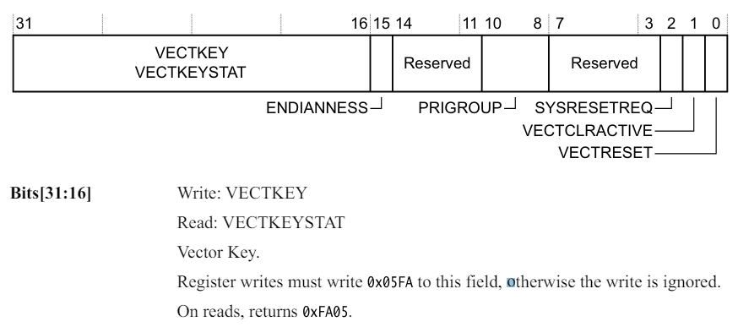
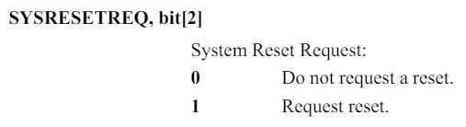
Interrupts and Exceptions
Reset Sequence
Soft Reset Example
Using Application Interrupt and Reset Control Register, AIRCR
0x20040000
0x20040000
0x2003fffc
0x2003fff8
0x0000008e
0x0000008F
0x20040000
The address value is equal to the actual address + 1 to let the processor know that the instructions to be executed are Thumb instructions.

Slide 19
Agenda
Interrupts and Exceptions
NVIC
GPIOTE
Interrupt Advanced Topic

Slide 20
Nested Vectored Interrupt Controller (NVIC)
NVIC
provides configurable interrupt handling abilities to the processor,
facilitates low-latency exception and interrupt handling,
and controls power management.

Slide 21
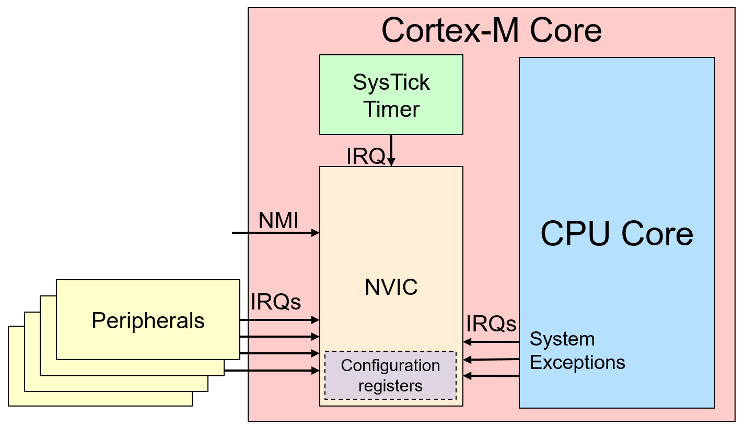
Nested Vectored Interrupt Controller (NVIC)
NVIC (Nested Vectored Interrupt Controller)
is a crucial component that manages interrupts in the ARMv7-M architecture.

Slide 22
Nested Vectored Interrupt Controller (NVIC)
NVIC (Nested Vectored Interrupt Controller)
is a crucial component that manages interrupts in the ARMv7-M architecture.
is characterized mainly by two features: it is "nested" and "vectored“
Nested
While one interrupt is being processed, another interrupt with a higher priority can occur and be handled.
Vectored
Each interrupt is assigned a unique number (vector), which directs the processor to jump directly to a specific function (Interrupt Service Routine, ISR) designed to handle that interrupt.

Slide 23
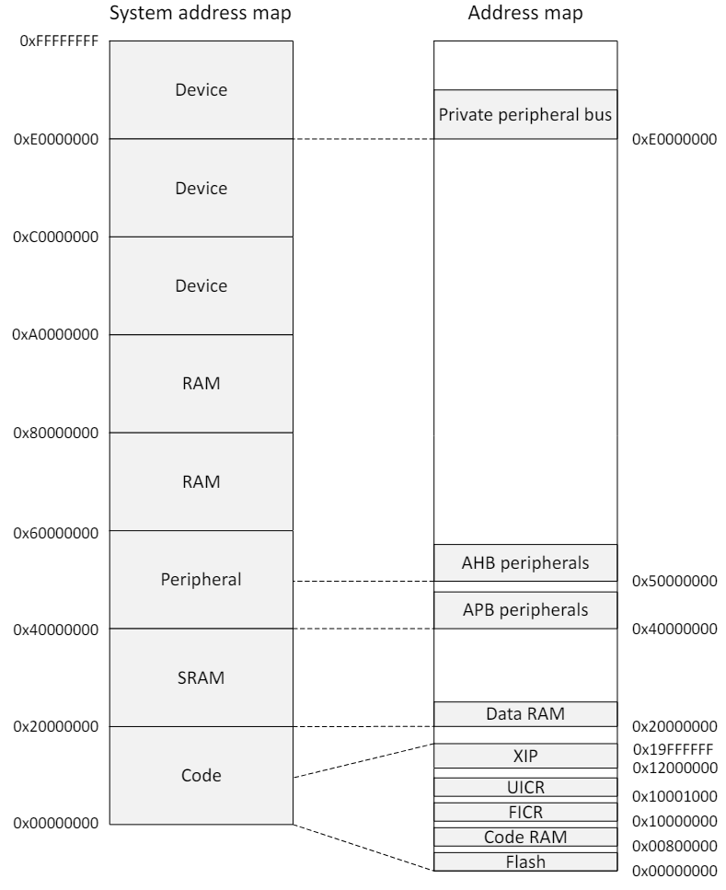
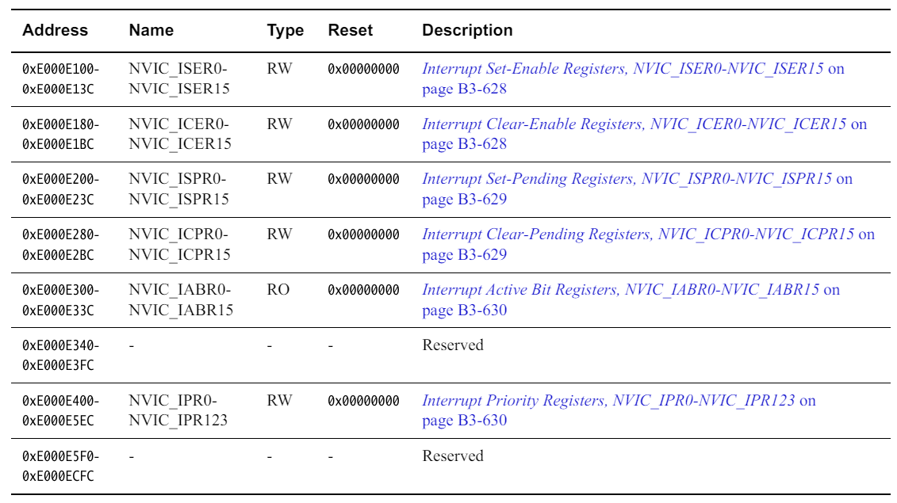
Nested Vectored Interrupt Controller (NVIC)
NVIC register summary
ICTR: Interrupt Controller Type Register (read only)
Information on the number of external interrupts
STIR: Software Triggered Interrupt Register (write only)
to change the status of an external interrupt to pending
NVIC

Slide 24
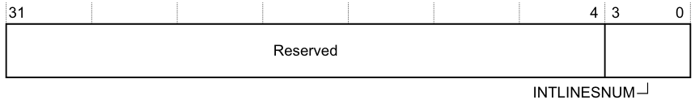
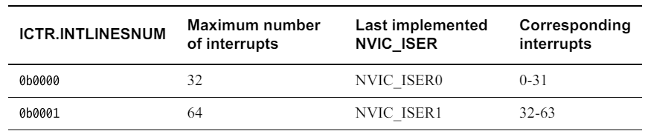
Nested Vectored Interrupt Controller (NVIC)
NVIC registers
ICTR: Interrupt Controller Type Register (read only, address: 0xE000E004)
Information on the number of external interrupts
INTLINESNUM, bits[3:0]
The total number of interrupt lines defined in groups of 32.
0b0001 in nRF52840 (Maximum number of interrupts: 64, two groups of 32 interrupts)

Slide 25
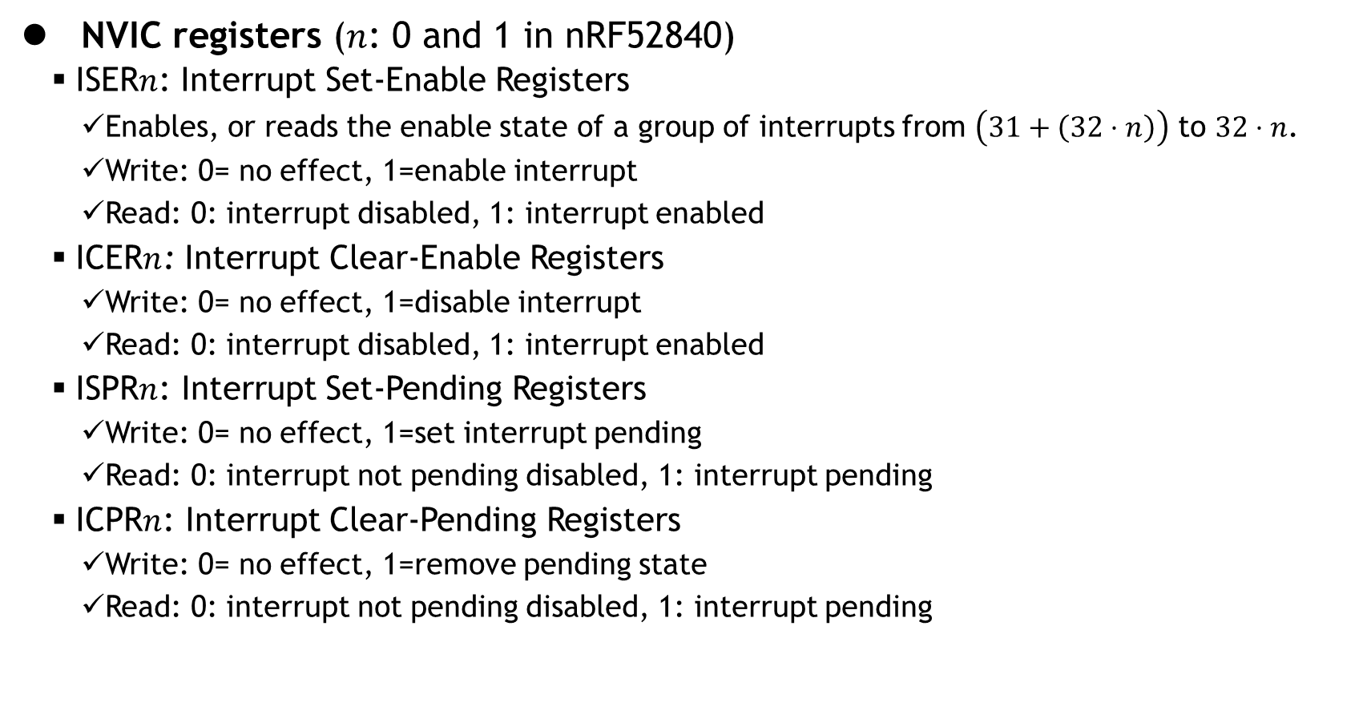
Nested Vectored Interrupt Controller (NVIC)
NVIC registers ($n$: 0 and 1 in nRF52840)
ISER$n$: Interrupt Set-Enable Registers
Enables, or reads the enable state of a group of interrupts from $\left(31+\left(32⋅n\right)\right)$ to $32⋅n$.
Write: 0= no effect, 1=enable interrupt
Read: 0: interrupt disabled, 1: interrupt enabled
ICER$n$: Interrupt Clear-Enable Registers
Write: 0= no effect, 1=disable interrupt
Read: 0: interrupt disabled, 1: interrupt enabled
ISPR$n$: Interrupt Set-Pending Registers
Write: 0= no effect, 1=set interrupt pending
Read: 0: interrupt not pending disabled, 1: interrupt pending
ICPR$n$: Interrupt Clear-Pending Registers
Write: 0= no effect, 1=remove pending state
Read: 0: interrupt not pending disabled, 1: interrupt pending

Slide 26
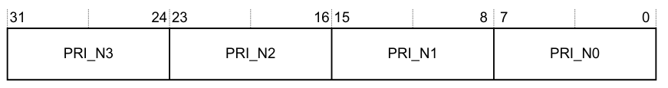
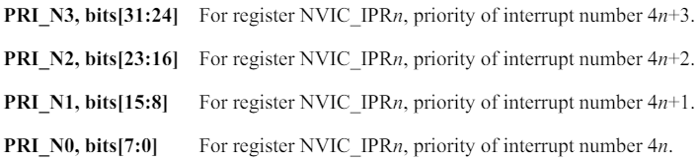
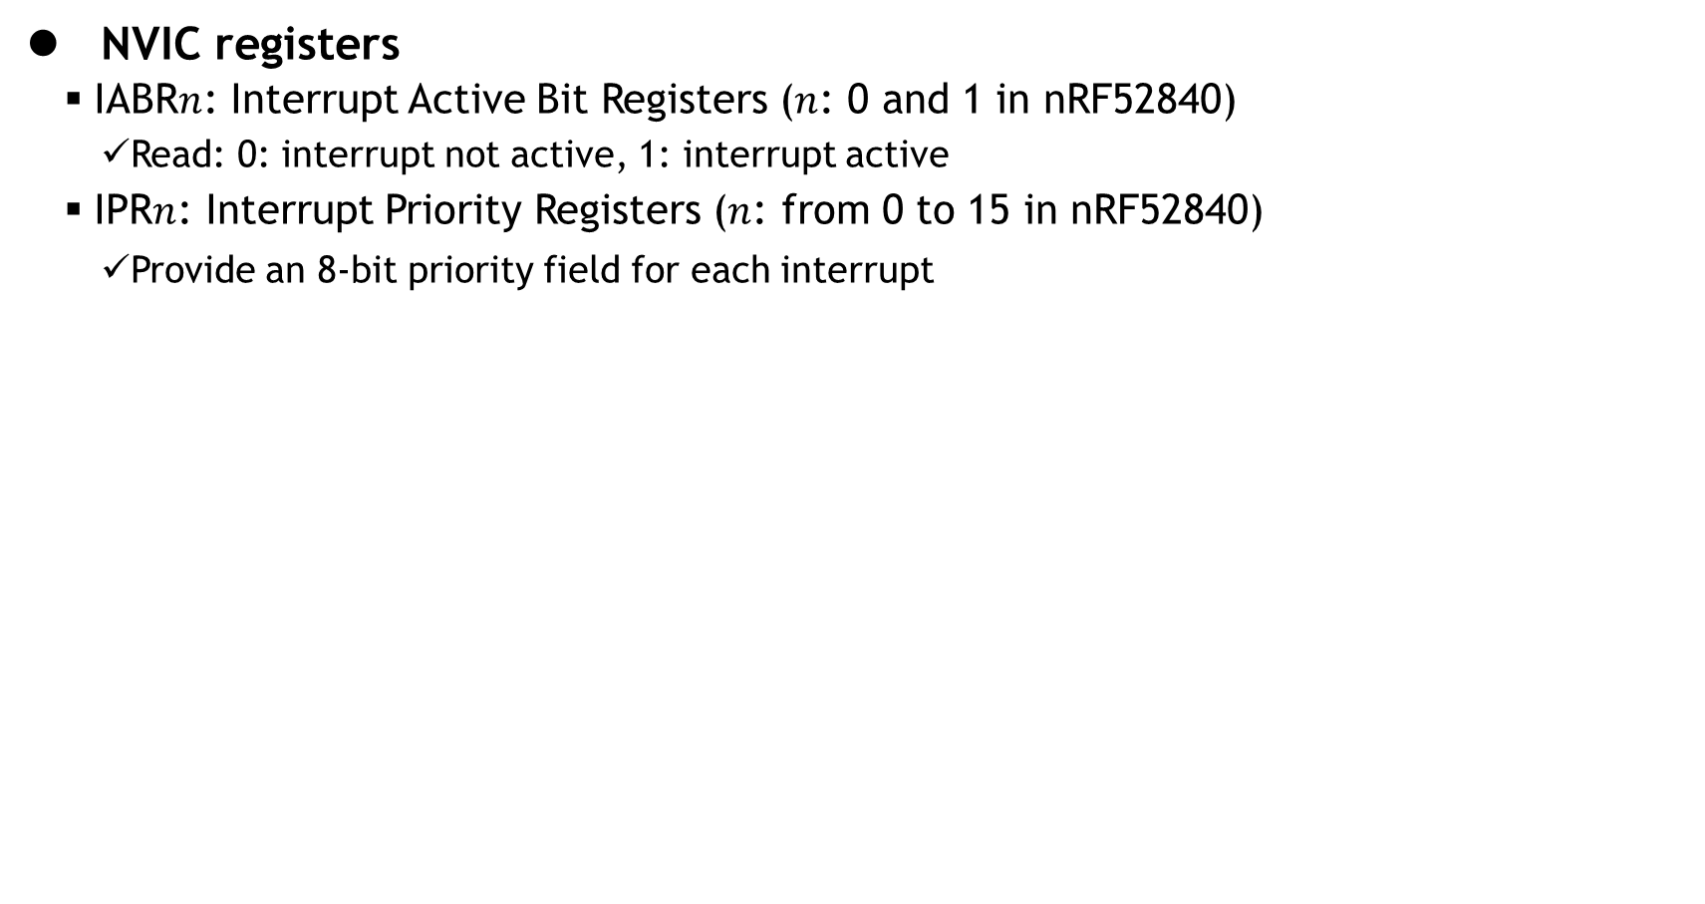
Nested Vectored Interrupt Controller (NVIC)
NVIC registers
IABR$n$: Interrupt Active Bit Registers ($n$: 0 and 1 in nRF52840)
Read: 0: interrupt not active, 1: interrupt active
IPR$n$: Interrupt Priority Registers ($n$: from 0 to 15 in nRF52840)
Provide an 8-bit priority field for each interrupt

Slide 27
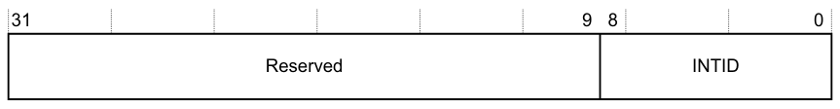
Nested Vectored Interrupt Controller (NVIC)
NVIC registers
STIR: Software Triggered Interrupt Register (write only, address 0xE000EF00)
provides a mechanism for software to generate an interrupt.
This register applies to implemented external interrupts only.
INTID, bits[8:0], indicates the interrupt to be triggered. The value written is (ExceptionNumber - 16).
Writing to this register has the same effect as setting the NVIC ISPR bit corresponding to the interrupt to 1
When the USERSETMPEND bit in the CCR (Configuration and Control Register) is set to 1, unprivileged software can access the STIR

Slide 28
Agenda
Interrupts and Exceptions
NVIC
GPIOTE
Power Management
Interrupt Advanced Topic

Slide 29
GPIOTE: GPIO tasks and events
GPIOTE: GPIO tasks and events
in the nRF52840 microcontroller
is an essential feature that detects state changes on GPIO pins and uses these changes to trigger specific tasks or generate events.
Key Features
Event Generation
Task Execution
Channel Configuration
Interrupt Capability

Slide 30
GPIOTE: GPIO tasks and events
GPIOTE: GPIO tasks and events
has 8 channels.
An event can be generated in each channel from one of the following input conditions.
Rising edge
Falling edge
Any change

Slide 31
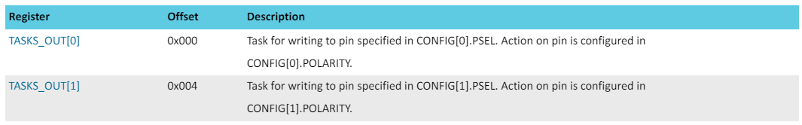
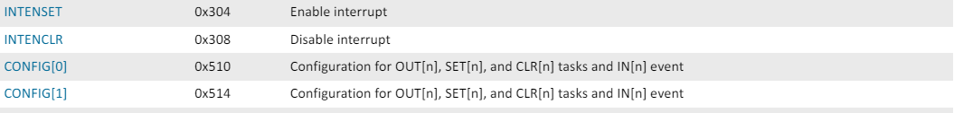
GPIOTE: GPIO tasks and events
GPIOTE Registers
Base address
0x40006000
…
…
…
We will focus on
this part for now. More details are
explained with examples.
…

Slide 32
Agenda
Interrupts and Exceptions
NVIC
GPIOTE
Power Management
Interrupt Advanced Topic

Slide 33
Exception Entry & Exit
AAPCS (Arm Architecture Procedure Call Standard) defines a set of conventions
It is around the registers which must be saved by a C function when calling function
ARM Hardware itself implements AAPCS
When an exception is invoked, the hardware automatically stack the registers that are caller-saved
The hardware then encode in the link register (LR) EXC_RETURN value
EXC_RETURN tells the ARM core how to return from exception
Stack Pointer Selection: If MSP (Main SP) or PSP (Process SP) be used when exiting the handler
Return Mode: return to Handler mode or Thread mode
Stack Frame State: If the stack includes floating-point context and aligns the stack accordingly
Typical EXC_RETURN values
0xFFFFFFF1 : Return to Handler mode using MSP
0xFFFFFFF9: Return to Thread mode using MSP
9xFFFFFFFD: Return to Thread mode using PSP

Slide 34
Tail-Chaining
When exiting an exception, the HW need to pop and restore at least 8 caller-saved registers.
Finding: When exiting an ISR while a new exception is already pended, the pop and subsequent push can be skipped since it would be popping and the pushing the exact same registers!
This Optimization ➔ Tail-Chaining
e.g. 18 cycles saving in Cortex-M3
12 clocks for executing an ISR + 12 clock to return from ISR
6 cycles to exit from one exception and start another one with Tail-chaining

Slide 35
Late-Arriving Preemption
ARM ore can detect higher priority exception while in the “exception entry phase” (stacking caller registers & fetching the ISR routine to execute)
A “late arriving” interrupt is detected during this period
The higher priority ISR can be fetched and executed but the register state saving that has already taken place can be skipped
This reduces the latency for the higher priority interrupt
upon completion of the late arriving exception handler, the processor can then tail-chain into the initial exception that was going to be serviced

Slide 36
Lazy State Preservation
ARMv7 & ARMv8 implements an optional FPU (Floating Point Unit) and comes with additional 33 four-bytes register (s0-s31 & fpscr)
17 of FPU registers are “caller” saved and need to be dealt with by ARM exception entry handler
FPU registers are not often used in ISRs ➔ Optimization by deferring the actual saving of the FPU registers on the stack until a flating point instruction is used in the exception (“Lazy Context Save”)
By deferring the actual push of the registers, interrupt latency be reduce by the push and pop of 17 registers!

Slide 37
Exception Priority & Priority Boosting
Priority Boosting is controlled via 3 registers
PRIMASK
__disable()_irq() or __enable_irq()
or cpsid i and cpsie i
FAULTMASK
__disable_fault_irg() and __enable_fault_irq()
or cpsid f and cpsie f
BASEPRI: prevent exceptions upon certain from being activated
__set_BASEPRI()

